Slide 1
2024 2026
Strategic Working Plan

Slide 2
Table of Contents
1.Overview
2.Vision and Mission
3.Core Values
4.Strategic Plan #1
5.Strategic Plan #2
6.Strategic Plan #3
7.The Team
8.Call to Action

Slide 3
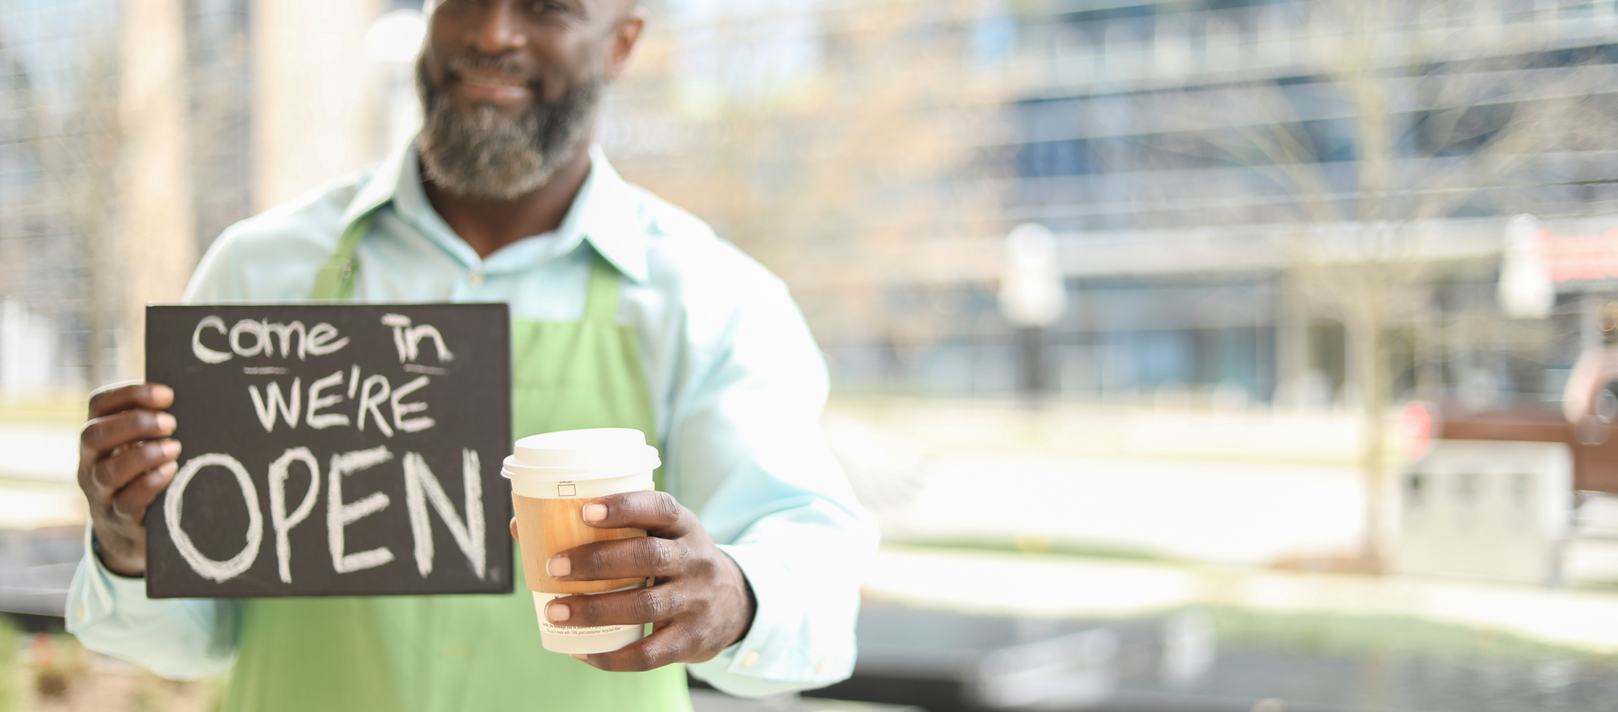
Overview
It began in 2008 with the concept that every household should have a viable source of diversified income to be a viable community supporter.
What began as a concept has now emerged as the Entrepreneur Infusion for community improvement through small businesses.

Slide 4
The Mission
To empower underprivileged and underserved small and home-based entrepreneurs with the necessary training and resources to thrive in a constantly changing technological and commercial landscape.
to Our Vision
The interaction of empowerment between entrepreneurs and their community involvement generates a synergy of resilience, which nurtures growth, inclusion, and collective success of economic empowerment within that community.

Slide 5
Our Core Values & Guiding Principles
Compassion
Empathy
Charity
Responsibility
Accountability
Our Core Values intertwined with our Guiding Principles of responsibility and accountability impact our entrepreneurs and their communities. We hold firm to the belief that all humankind is unique in its creativity and unified as a community through its contribution.

Slide 6
Strategic Plan #1
Entrepreneur capability and stability
Objective:
To facilitate the growth and development of the entrepreneur’s idea into a viable concept.
NMPP Individual Trainings
NMPP Group Sessions
Workstations

Slide 7
Strategic Plan #2
To build synergy between entreprenuer and Community
Objective:
To strengthen cooperation and collaboration between community organizations and entrepreneurs.
Organization Partnership
Organization Group Trainings

Slide 8
Strategic Plan #3
To create Entrepreneur Infusion
Objective:
To foster economic empowerment through entrepreneur infusion within disadvantaged, underserved communities.
Entrepreneur Infusion
Community Involvement
Mentorship
Workforce
Contributing Support

Slide 9
ENTRREPRENEUR+COMMUNITY ORGANIZATION=STRONGER COMMUNITIES.
Team Effort
NMPP
Entrepreneurs
Community Organizations

Slide 10
Thank You
For further inquiries and information
NO MORE POVERTY PRODUCTIONS, INC.
PO Box 1921, Pearland, TX 77588
PH: 713 498 1148
EMAIL: nomorepovertypro@gmail.com
WEB: www.nmpp.info

